Slide 1

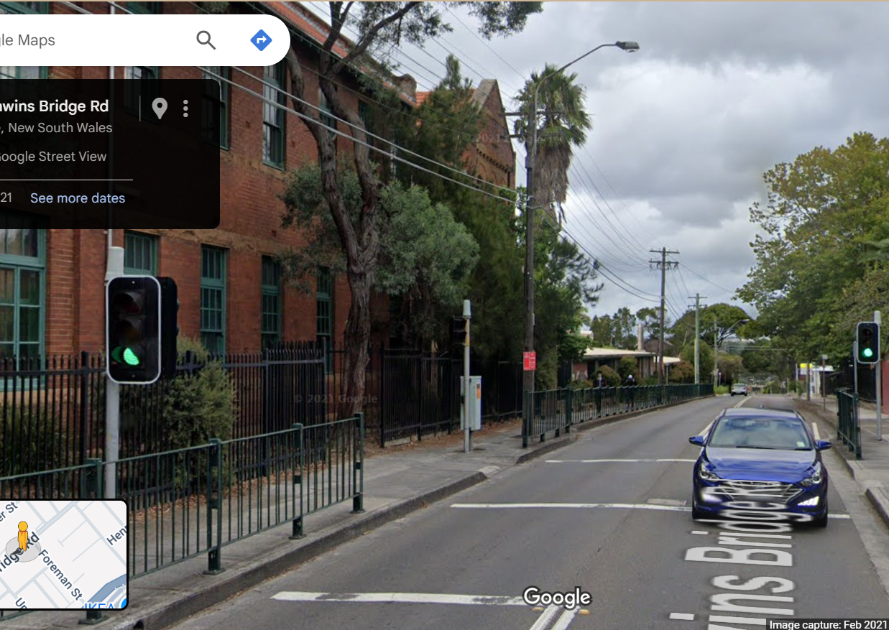
Pi Pico OOP Mini Project
Ben Jones
Tempe High School
Lecture 5
Notes:
Welcome to Lecture 5! So far, we have created fully functioning classes for both the LED_light and pedestrian_button components, along with unit tests for each class.

Slide 2

Simple Open Loop Control System
Traffic Lights remain green until pressed (idle state).
Button pressed triggers state change.
Lights rotate through a pattern based on time.
System returns to idle state
Notes:
In this lecture, we will focus on the auditory notification system. This notification is designed to make crossing the street more accessible for users who are blind or vision-impaired, serving as a user interface to let them know when it is safe to cross.

Slide 3
Today
Implement an audio notification Class including a beep
Write documentation for our Class
Unit test the audio notification
Notes:
Today we will
??
implement an audio notification Class
uses a series of beeps
Write developer documentation for the Class
Then, write a unit test for the audio notification Class

Slide 4

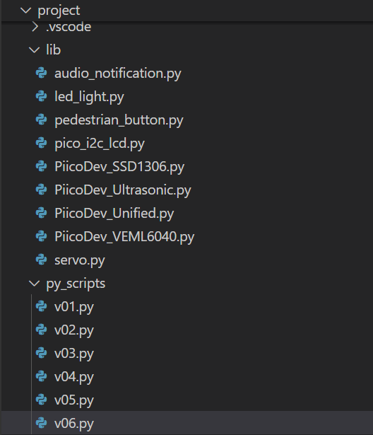
Create new files
v06.py in project\py_scripts\
audio_notification.py in project\lib\
Notes:
Start by creating a file named v06.py in the py_scripts folder, where you will write your unit tests. Next, create a file named audio_notification.py in the lib folder, where you will develop your audio notification class as an abstraction, separate from your main program logic.

Slide 5
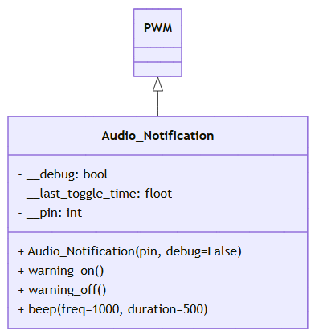
UML
Notes:
This is the UML diagram for our Audio_Notification class. The class inherits from the PWM class and utilises its inherited methods, but it does not implement any polymorphism. It has attributes for debugging, timing, and the pin number. The class also includes methods to produce a single beep and to turn the warning on or off.

Slide 6
Audio_Notification Imports
from machine import Pin, PWM
from time import sleep, time
Notes:
These are the imports for our class. PWM will be our superclass, which is different from the LED or button classes. Once again, we will use the time module as an associated class. I want to note that I am not including time in the UML diagram, in order to keep the diagrams clearer and easier to understand.

Slide 7
Audio_Notification Class Initialiser & Attributes
Class Audio_Notification(PWM):
def __init__(self, pin, debug=False):
super().__init__(Pin(pin))
self.__pin = pin
self.__debug = debug
self.__duty_u16(0) # Start with buzzer off
self.__last_toggle_time = time()
Notes:
The class initialiser calls the initialiser of the superclass using super(), and then stores the attributes as encapsulated (private) variables.

Slide 8
Audio_Notification .beep() Method
def beep(self, freq=1000, duration=500):
if self.__debug:
print("Beep")
self.freq(freq)
self.__duty_u16(32768) # 50% duty cycle
sleep(duration / 1000)
self.__duty_u16(0) # Turn off after beep
Notes:
First, we need to create a single beep method that can be called at intervals to produce a warning signal. Once you have implemented this method, you can create an instance of the class and call object.beep() to test the beep. Although using sleep makes this method blocking, the delay is brief, so this trade-off is acceptable for a simple implementation.

Slide 9
Audio_Notification .warning_on() Method
def warning_on(self):
if self.__debug:
print("Warning on")
now = time()
if now - self.__last_toggle_time >= 0.5:
self.beep(freq=500, duration=100)
self.__last_toggle_time = now
Notes:
This is a non blocking method that calls the beep every 0.5 seconds to create a warning sound.

Slide 10
Audio_Notification .warning_off() Method
def warning_off(self):
if self.__debug:
print("Warning off")
self.__duty_u16(0) # Turn off sound
Notes:
This method sets the PWM duty cycle to zero which means there is no current in the PWM signal turning the audio notification off

Slide 11
Add documentation to your Class
Class LedPico:
"""
Simple Class to turn an LED on or off on a Raspberry Pi Pico.
Args:
pin (int): GPIO pin number for the LED.
Example:
led = LedPico(25) # Onboard LED
led.set(True) # Turn on
led.set(False) # Turn off
"""
def __init__(self, pin):
from machine import Pin
self.led = Pin(pin, Pin.OUT)
def set(self, state: bool):
"""
Set the LED on or off.
Args:
state (bool): True to turn on, False to turn off.
"""
self.led.value(1 if state else 0)
Class-level docstring: Briefly describes what the Class represents and lists its attributes and methods.
Constructor docstring: Explains what parameters are needed to create an instance.
Method docstrings: Describe what each method does and what parameters it takes.
Notes:
Using the example provided as a template, write developer documentation for your audio notification class. Focus on describing the purpose of each method (what it does and why), rather than how it is implemented. For instance, “Set the LED on or off” is good documentation because it explains the function’s role, while “Set pin high or low” is less helpful, since it only describes the technical action without any context.

Slide 12
Unit Test the Audio_Notification Class
Your unit test should test all methods, where possible, because it involves an auditory sound you should design a manual test.
Pause the video, design your unit test, then check your unit tests against my suggested batch of unit tests.
Notes:
Your final task is to design and implement a unit test for your AudioNotification class in v06.py. Since the class produces auditory output, you will need to manually verify whether the test passes (for example, by listening for the beep). Pause here to complete the task, and when you’re finished, review my solution to see how your work compares.

Slide 13
